Slide 1
Assignment for CT
MD SIFAT ULLAH SHEIKH
2022-1-60-029

Slide 2
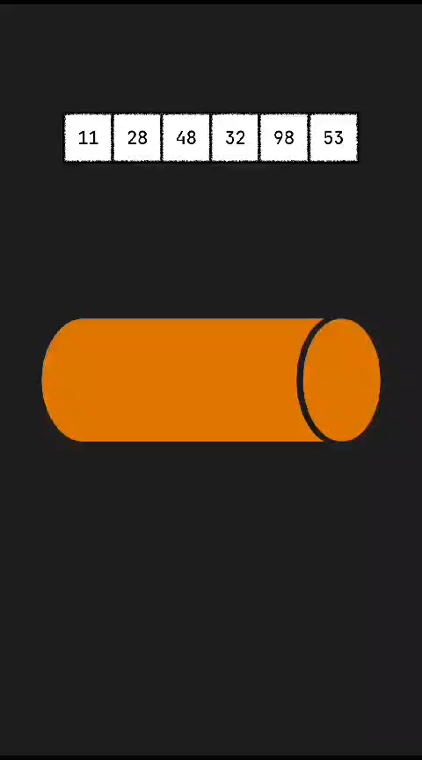
Priority Queues: Priority queue does not have specified ends, so insertion does not happen at a specific end, and deletion also does not happen at a specific end.
Here is a animated video of how priority queues works.
2

Slide 3
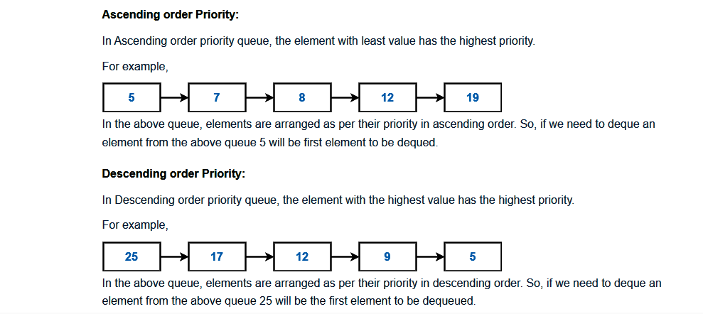
Types of Priority queue.
Ascending order Priority
Descending order Priority
3

Slide 4
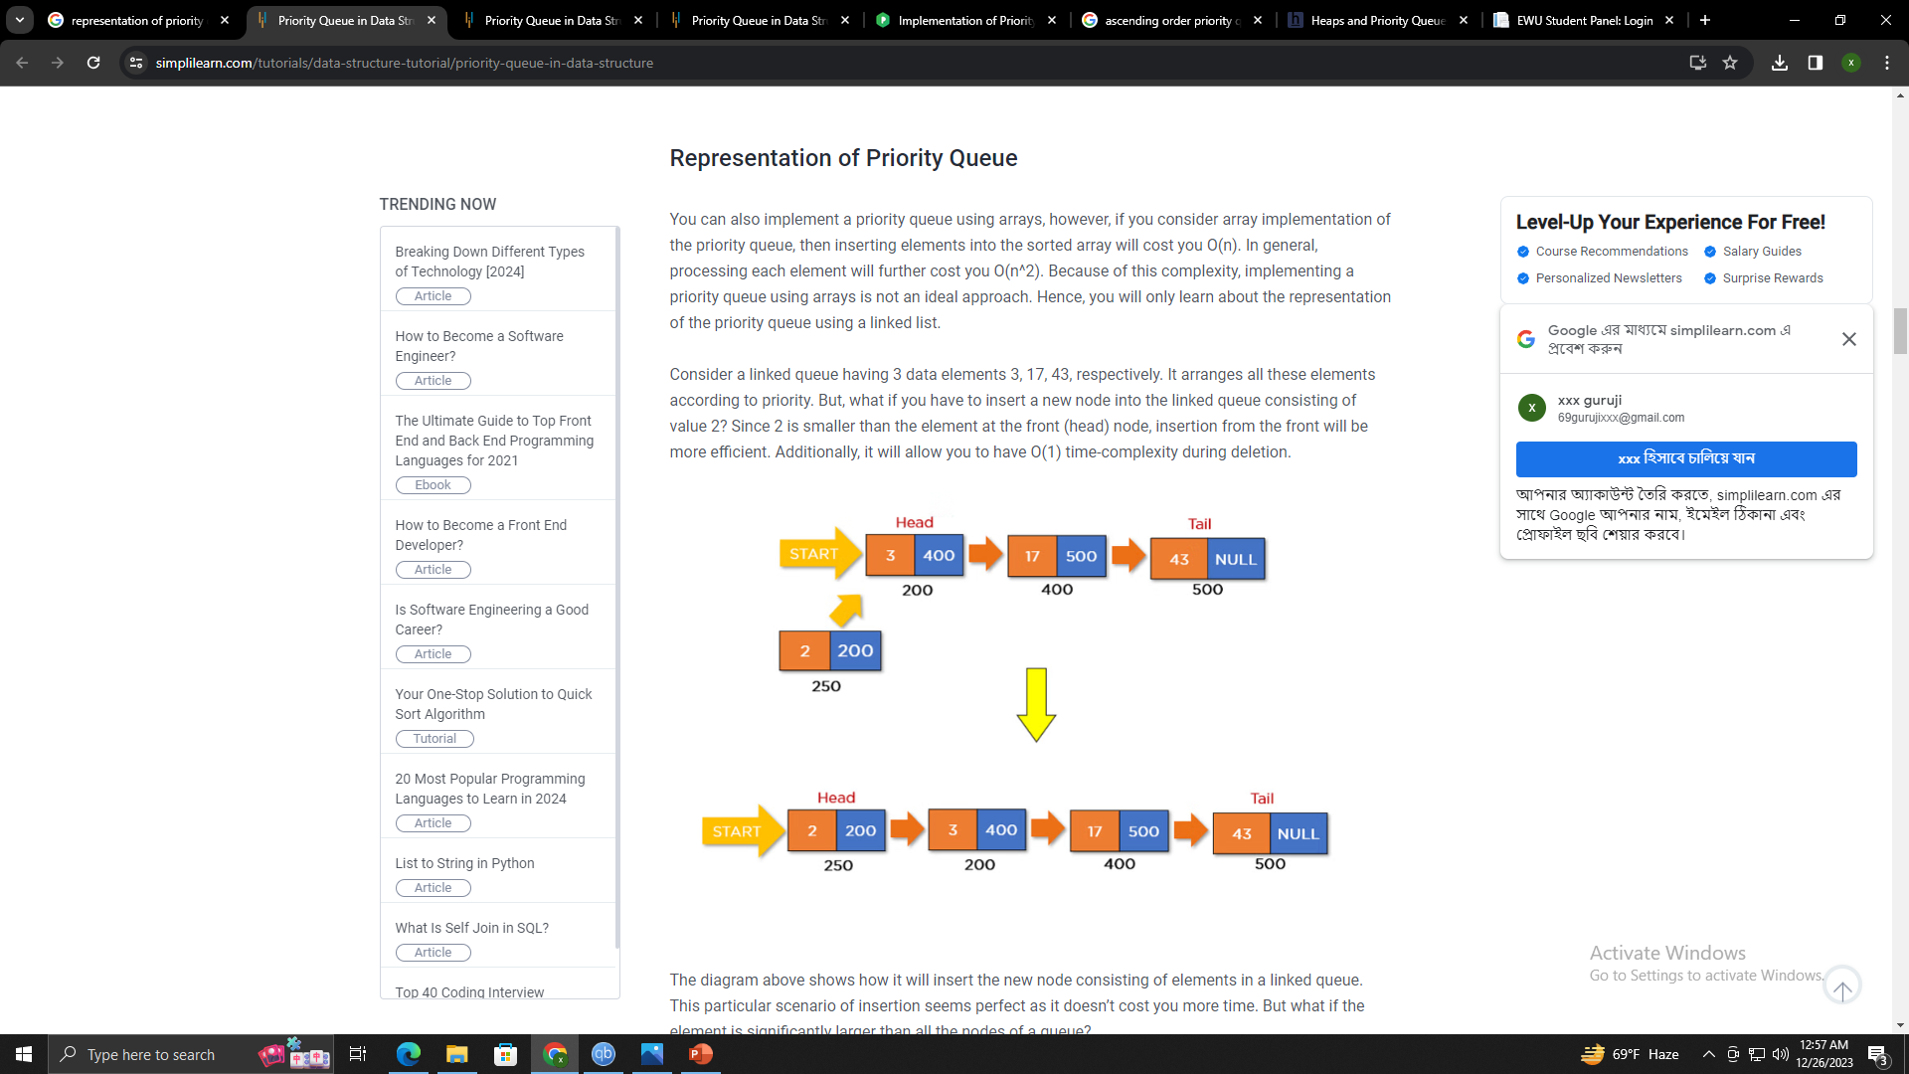
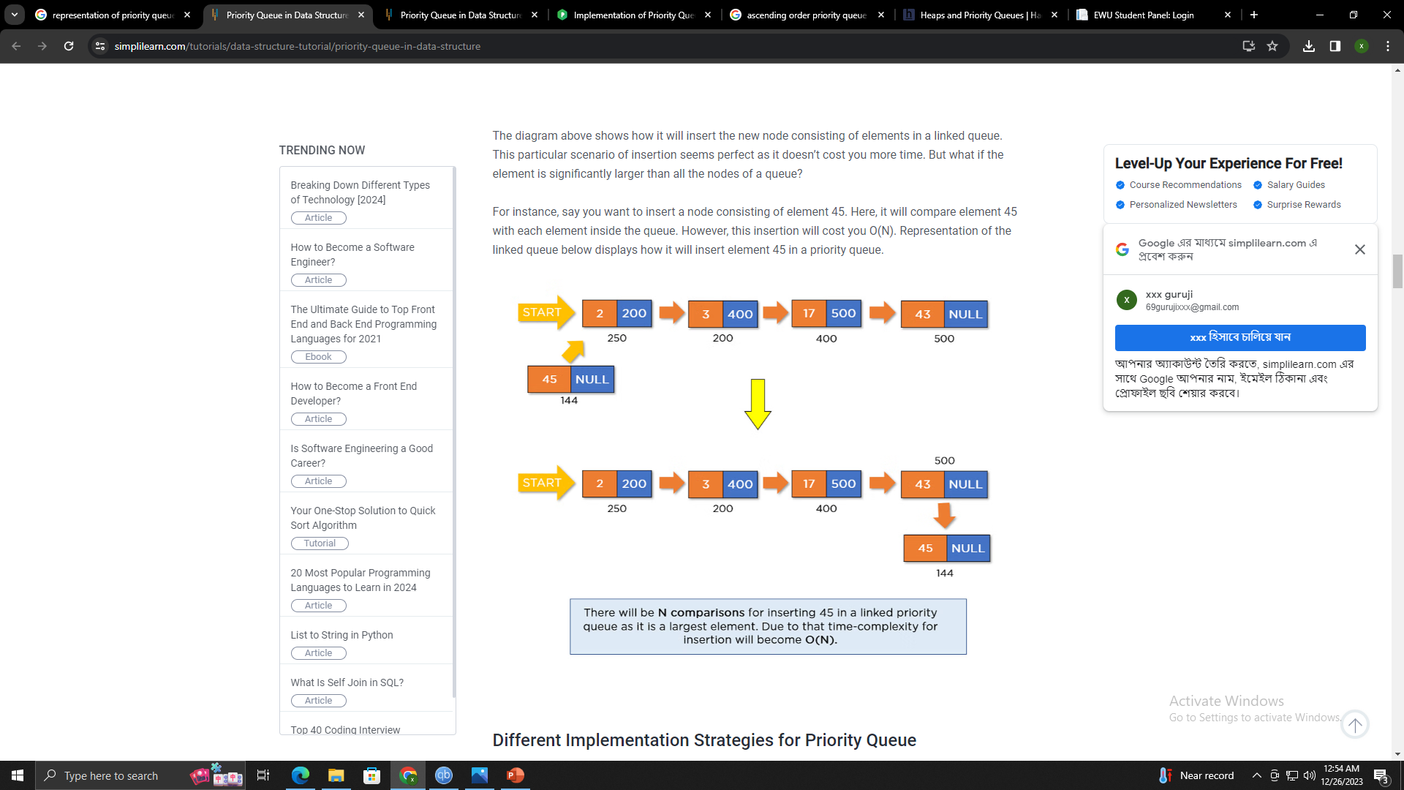
Representation of priority queue

Slide 5
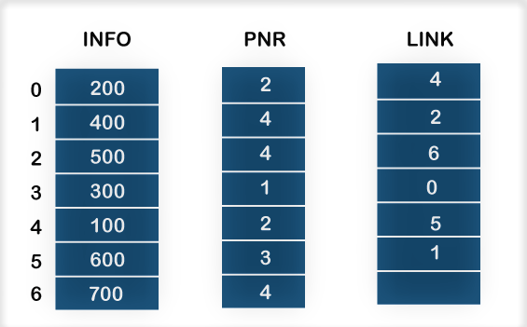
Representation of priority queue
INFO list contains the data elements.
PNR list contains the priority numbers of each data element available in the INFO list.
LINK basically contains the address of the next node.

Slide 6
Characteristics of a Priority Queue?
Each item has some priority associated with it.
An item with the highest priority is moved at the front and deleted first.
If two elements share the same priority value, then the first priority queue follows -in-first-out principle for de queue operation.

Slide 7
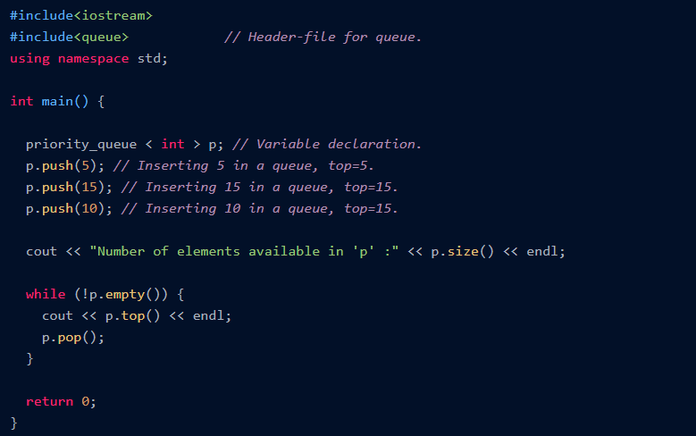
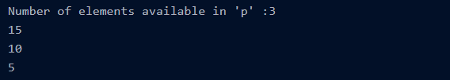
Syntax The general syntax of Priority Queue in C++ is :
Example :
Output:

Slide 8
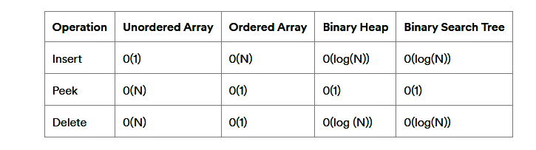
The complexity of different operations in a priority queue.
8

Slide 9

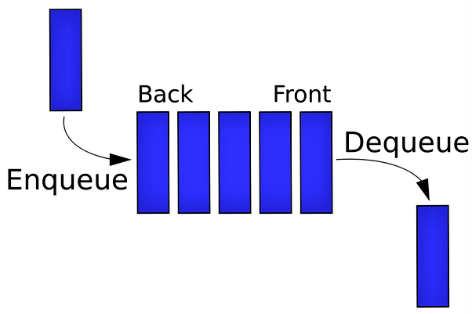
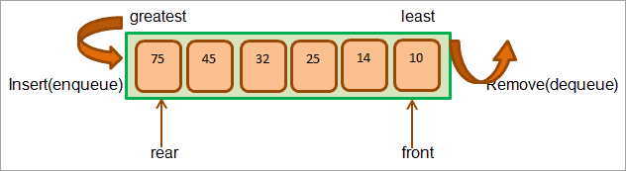
What is the difference between a priority queue and a queue?
Queue
Priority Queue:
A Queue is a data structure that has a front and back. Its often abbreviated as FIFO (First in First Out)
Priority queue does not have specified ends, so insertion does not happen at a specific end, and deletion also does not happen at a specific end.
9

Slide 10
Methods of Priority Queue in C++
Methods
Definition
empty()
Returns whether the queue is empty.
size()
Returns the size of the queue.
top()
Returns a reference to the topmost element of the queue.
push()
Adds the element ‘g’ at the end of the queue.
pop()
Deletes the first element of the queue.
emplace()
Used to insert a new element into the priority queue container.
10

Slide 11
Implementation of the Priority Queue in Data Structure You can implement the priority queues in one of the following ways : Linked list Binary heap Arrays Binary search tree The binary heap is the most efficient method for implementing the priority queue in the data structure.

Slide 12
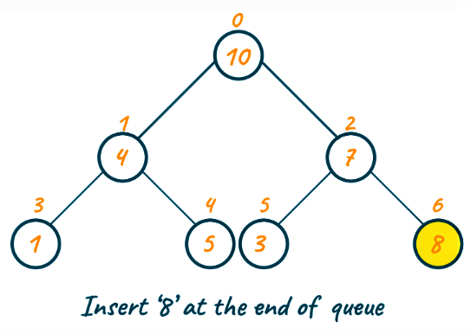
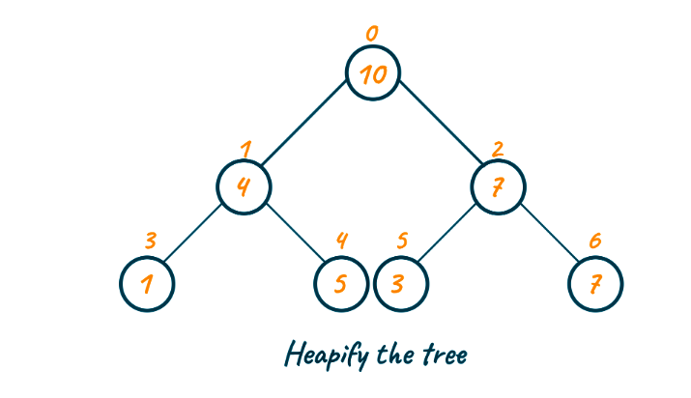
Insertion :

Slide 13
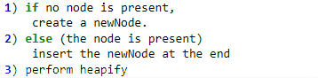
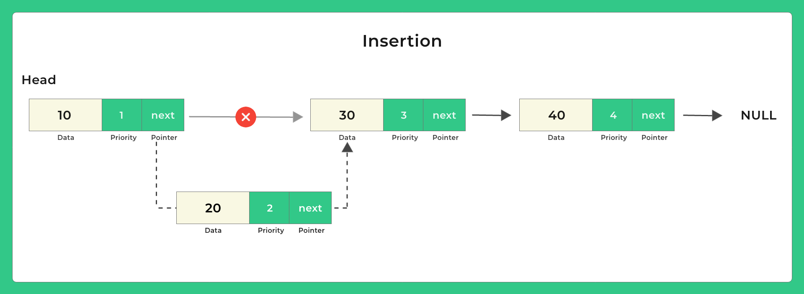
Algorithm for insertion operation in the priority queue

Slide 14
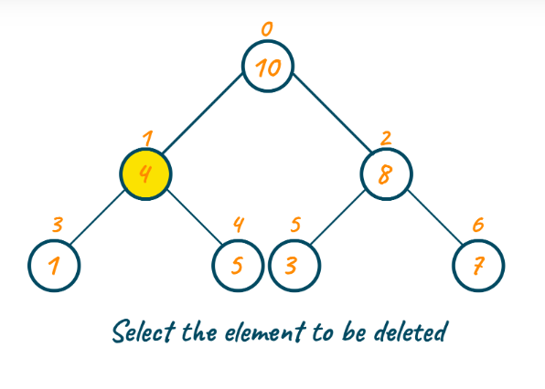
Deletion :

Slide 15
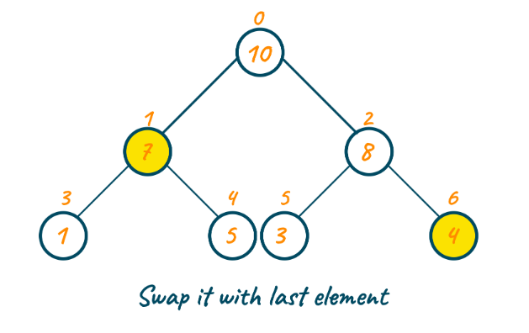
Deletion :

Slide 16
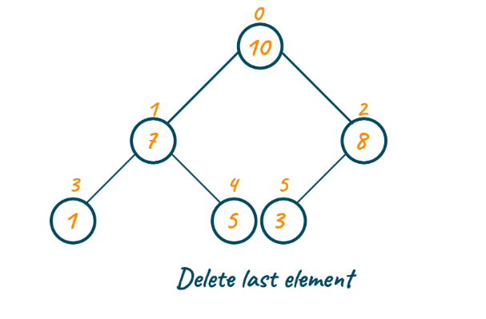
Deletion :

Slide 17
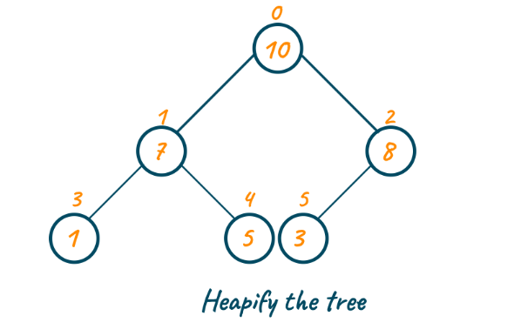
Deletion :

Slide 18
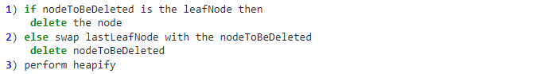
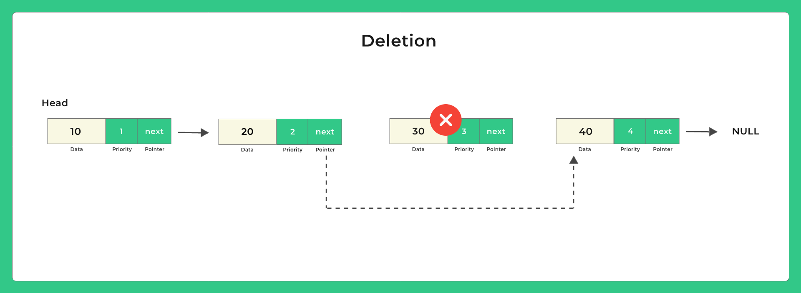
Algorithm for deletion operation in the priority queue :

Slide 19
Advantages of Priority Queue 1. Easy to implement. 2. Processes with different priorities can be handled efficiently. 3. Application with differing requirements.

Slide 20
DISADVANTAGES :
1. High complexity. Priority queues are more complex than simple data structures like arrays and linked lists, and may be more difficult to implement and maintain.
2. High consumption of memory. Storing the priority value for each element in a priority queue can take up additional memory, which may be a concern in systems with limited resources.

Slide 21
Applications of Priority Queue
1. Priority queue is used in Dijkstra's algorithm for finding the shortest path
2. It is used in Prim’s algorithm to store keys of nodes at every step
3. Priority queue is used in data compression
4. Priority queue is used in Huffman Coding algorithm
5. It is used in artificial intelligence algorithms such as the A* search algorithm
6. It is used to implement a heap sort algorithm
7. Priority queue is used in Operating System as the scheduling algorithm
8. It is used in interrupt handling of your system
9. Priority queue is used in CPU scheduling and Disk scheduling algorithm
10. It is also used in Stack implementation

Slide 22
Conclusion : Identifying the priorities and doing tasks accordingly allows you with faster and effective results. Therefore, it is highly recommended to learn priority queue in C++ and take high advantage of all its applications.

